Slide 1
The Boys
Our C++ project about biology

Slide 2
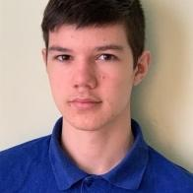
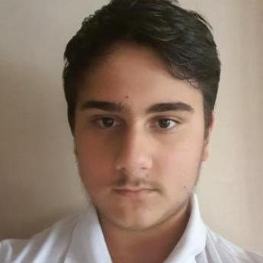
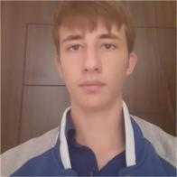
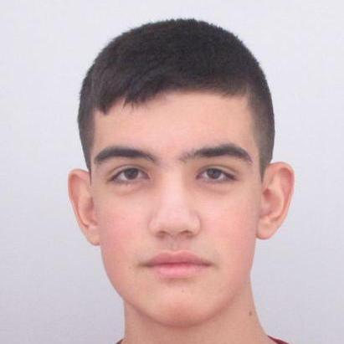
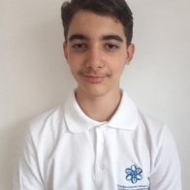
Our Team
Mario Zlatev Backend Developer
Bozhidar Boyadzhiev Backend Developer
Denis Kolev Scrum Trainer
Georgi Zhekov Backend Developer
Kliment Tenev Designer

Slide 3

Idea Of The Project

Slide 4
Stages Of Progress
1.
2.
3.
4.
Coming Up With An Idea
Realizing The Idea
Checking For Errors
Creating The Documentation

Slide 5







Apps, Tools and Programming Languages We’ve Used

Slide 6
Now onto the game!

Slide 7
Thank you for your attention!

